Slide 1
Cherokee Nation v. Georgia
By: Tyler Willgens

Slide 2
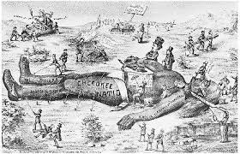
Dates
In 1830, a group of Cherokee leaders went to Washington, D.C., the capital of the United States. They were there to present a petition to government officials.

Slide 3
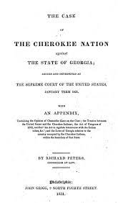
Case Background information
For hundreds of years Indians lived out west in the united states even when white men when where starting to civilize out there too but they always kept a boundary. Until recently the government is making it harder for them to keep there land.

Slide 4
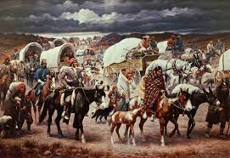
Main Facts
In 1802 the federal government told Georgia settlers that they could have Indian land.
Politicians tried negotiating with the Indians to have there land.
In 1828 they past a law which they could strip the Indians off their land and take it from them.

Slide 5
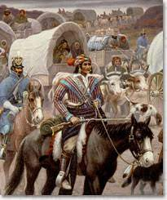
outcome
the U.S. Supreme Court ruled that the Cherokee Nation was sovereign. Which meant that the Georgia government had no right to take their land.

Slide 6
resources
Cherokee Nation v. Georgia: The Case and Its Impact
https://www.thoughtco.com › ... › U.S. Legal System
Cherokee Nation v. State of Georgia (1831) and Worcester v.
https://bluecerealeducation.com › cherokee-nation-v-sta...

